Slide 1


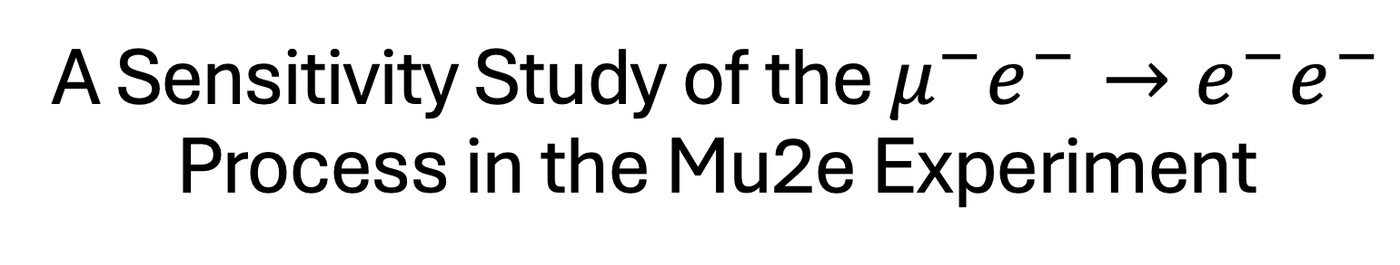
A Sensitivity Study of the $μ^{−}e^{−}→e^{−}e^{−}$ Process in the Mu2e Experiment
Andrew Boldy
Major Professor: Dr. Dave Tedeschi
USC Committee Members: Dr. Alexey Petrov, Dr. Matthias Schindler
External Committee Member: Dr. Bertrand Echenard (Cal Tech)
University of South Carolina
October 8th, 2026

Slide 2
Presentation Roadmap
1
Theoretical Motivation
Slides 3–11
The Standard Model, charged lepton flavor violation specifically μ⁻e⁻ → e⁻e⁻ as a stand-out process
2
The Mu2e Experiment
Slides 12–20
How Mu2e produces, stops, and detects muons, and the backgrounds it must suppress
3
Event Identification and Signal
Slides 21–26
Two back-to-back 52.8 MeV electrons from one common vertex, and the run conditions to see them
4
Initial Investigation
Slides 27–35
Validated toy generator, 16.8% candidate efficiency, first reconstructed common vertex
5
Goals and Deliverables
Slides 36–43
Helical vertexing, background mixing, theory-driven generator, full sensitivity estimate

Slide 3
Section 1 of 5
Theoretical Motivation
1
Theoretical Motivation
Slides 3–11
Why search for charged lepton flavor violation?
2
The Mu2e Experiment
Slides 12–20
How does Mu2e isolate a single conversion electron?
3
Event Identification and Signal
Slides 21–26
What does μ⁻e⁻ → e⁻e⁻ look like in the detector?
4
Initial Investigation
Slides 27–35
What have I shown so far?
5
Goals and Deliverables
Slides 36–43
What will the dissertation deliver, and by when?

Slide 4



























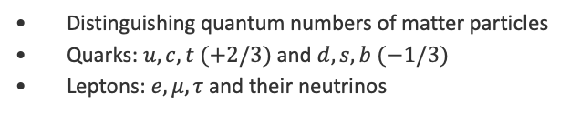
The Standard Model of Particle Physics
Matter, forces, and flavor in an SU(3)_{c} × SU(2)_{L} × U(1)_{Y} gauge theory
Generation
I
II
III
Bosons
$$+2/3$$
$$+2/3$$
$$+2/3$$
$$0$$
$$0$$
Matter particles: fermions
$$u$$
$$c$$
$$t$$
$$g$$
$$H$$
Quarks, with positive and negative charge
Leptons, charged and uncharged
Quarks
up
charm
top
gluon
Higgs
$$−1/3$$
$$−1/3$$
$$−1/3$$
$$0$$
Interaction particles: bosons
$$d$$
$$s$$
$$b$$
$$γ$$
Gluons, photon, Z and W bosons carry the forces
Higgs boson, responsible for masses
down
strange
bottom
photon
$$−1$$
$$−1$$
$$−1$$
$$0$$
Flavor
$$e$$
$$μ$$
$$τ$$
$$Z$$
Distinguishing quantum numbers of matter particles
Quarks: $u, c, t (+2/3)$and $d, s, b (−1/3)$
Leptons: $e, μ, τ$and their neutrinos
Leptons
electron
muon
tau
Z boson
$$0$$
$$0$$
$$0$$
$$±1$$
$$ν_{e}$$
$$ν_{μ}$$
$$ν_{τ}$$
$$W^{±}$$
Symmetries
e neutrino
μ neutrino
τ neutrino
W boson
Required: the gauge group symmetries
Accidental: baryon number, lepton number, lepton flavor number
$$L_{e}$$
$$L_{μ}$$
$$L_{τ}$$
Quarks
Leptons
Lepton flavor numbers
Gauge bosons
Scalar boson
Notes:
Next slide keeps every cell in place and highlights the leptons. Apply the Morph transition to the next slide for a smooth color change.

Slide 5



























The Standard Model of Particle Physics
Lepton flavor looks conserved, but no gauge symmetry requires it
Generation
I
II
III
Bosons
$$+2/3$$
$$+2/3$$
$$+2/3$$
$$0$$
$$0$$
Gauge symmetry: SU(3)_{c} × SU(2)_{L} × U(1)_{Y}
$$u$$
$$c$$
$$t$$
$$g$$
$$H$$
Accidental symmetries, not required by the gauge group:
Quarks
up
charm
top
gluon
Higgs
Baryon number B
Lepton number L
Lepton flavor number, one per family
$$−1/3$$
$$−1/3$$
$$−1/3$$
$$0$$
$$d$$
$$s$$
$$b$$
$$γ$$
down
strange
bottom
photon
$$−1$$
$$−1$$
$$−1$$
$$0$$
Charged leptons: no flavor change seen
$$e$$
$$μ$$
$$τ$$
$$Z$$
Charged lepton flavor violation (CLFV) never observed
Leptons
electron
muon
tau
Z boson
$$0$$
$$0$$
$$0$$
$$±1$$
Neutrinos: flavor changes
$$ν_{e}$$
$$ν_{μ}$$
$$ν_{τ}$$
$$W^{±}$$
Oscillations observed, such as ν_{μ} → ν_{e}
e neutrino
μ neutrino
τ neutrino
W boson
$$L_{e}$$
$$L_{μ}$$
$$L_{τ}$$
Lepton flavor numbers

Slide 6
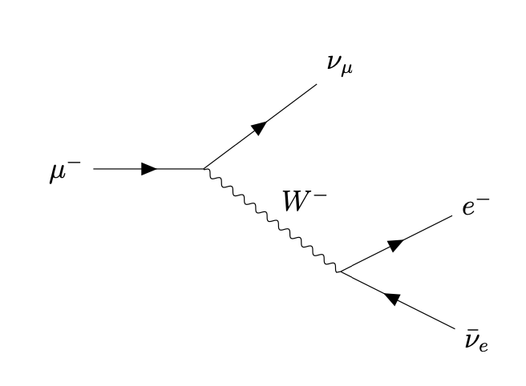
Conservation Laws in Muon Decay
Charge(s) and energy are guaranteed by fundamental symmetry; lepton flavor appears conserved but not required.
Required by symmetry
Conserved quantity | Symmetry behind it | In this decay
Energy, momentum | Translations (Noether) | 105.7 MeV shared by three daughters
Angular momentum | Rotations (Lorentz invariance) | Spin ½ → three spin-½ leptons
Electric charge Q | U(1)_{EM} gauge symmetry | −1 → (−1) + 0 + 0
Color | SU(3)_{c} gauge symmetry | No colored particles involved
Accidental: conserved, but no symmetry demands it
Number | μ⁻ | e⁻ | ν̄_{e} | ν_{μ} | Before → after
B | 0 | 0 | 0 | 0 | 0 → 0 | ✓
L | +1 | +1 | −1 | +1 | +1 → +1 | ✓
L_{e} | 0 | +1 | −1 | 0 | 0 → 0 | ✓
L_{μ} | +1 | 0 | 0 | +1 | +1 → +1 | ✓
L_{τ} | 0 | 0 | 0 | 0 | 0 → 0 | ✓
$$μ^{−}→e^{−}+\overline{ν_{e}}+ν_{μ}$$
Dominant Standard Model decay, via a virtual, off-shell, W⁻
The muon neutrino carries the muon flavor in the final state and the electron anti neutrino cancels with the electron flavor.
Without these properties, this process wouldwould change L_{μ} and L_{e}: that is CLFV.
Notes:
Required laws follow from Noether: translations give energy-momentum, rotations give angular momentum, gauge symmetries give charge and color. B, L, and the three flavor numbers follow from the particle content only (accidental). Neutrino oscillations already show L_e, L_mu, L_tau are not exact.

Slide 7
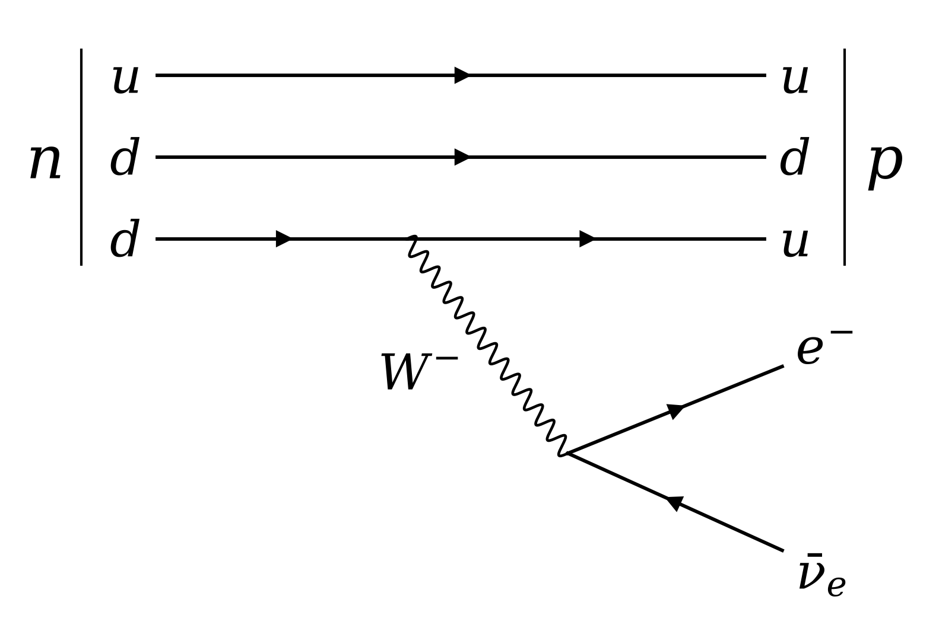

Conservation Laws in Beta-Minus Decay
The W boson changes quark flavor, yet lepton flavor still shown to balance between initial and final states.
Required by fundamental symmetries
Conserved quantity | Symmetry behind it | In this decay
Energy, momentum | Translations | Q-value: m_{n} − m_{p} − m_{e} ≈ 0.78 MeV
Angular momentum | Rotations | Spin ½ → three spin-½ particles (accessible)
Electric charge Q | U(1)_{EM} gauge symmetry | 0 → (+1) + (−1) + 0
Color | SU(3)_{c} gauge symmetry | d → u keeps its color
Accidental: conserved, but gauge symmetry does not demand it
Number | n | p | e⁻ | ν̄_{e} | Before → after
B | +1 | +1 | 0 | 0 | +1 → +1 | ✓
L | 0 | 0 | +1 | −1 | 0 → 0 | ✓
L_{e} | 0 | 0 | +1 | −1 | 0 → 0 | ✓
L_{μ} | 0 | 0 | 0 | 0 | 0 → 0 | ✓
L_{τ} | 0 | 0 | 0 | 0 | 0 → 0 | ✓
$$n →p+e^{−}+\overline{ν_{e}}$$
Nuclear process in which a neutron converts to a proton via charged currents
Quark flavor changes through the charged-current weak interaction, with the CKM matrix governing quark mixing. Charged-lepton flavor violation is enormously suppressed in the Standard Model with massive neutrinos, owing to a GIM-like cancellation and the tiny neutrino-mass splitting. For example, $Br\left(μ→eγ\right)\sim {10}^{−54},$ far below experimental sensitivity.
Altmannshofer et al. [4]; Calibbi & Signorelli [10]
Notes:
Contrast with muon decay: the weak charged current changes quark flavor (d to u) through CKM mixing, so flavor is not a fundamental conservation law. Lepton flavor is conserved in the Standard Model only because of its particle content. Q-value uses m_n = 939.57, m_p = 938.27, m_e = 0.511 MeV.

Slide 8
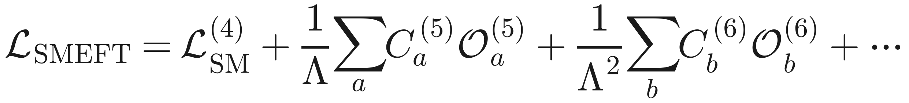
Effective Field Theory
EFT turns a limit on a CLFV process into a constraint on new physics, without choosing a model
Brivio & Trott [1]
Λ
Scale of new physics; each extra dimension costs a power of 1/Λ
C_{i}
Wilson coefficients: dimensionless strengths that experiments constrain
𝒪_{i}
Operators: allowed by the Standard Model gauge symmetries
Each operator dimension adds new physics
D = 4
Renormalizable
D = 5
Suppressed by 1/Λ
D = 6
Suppressed by 1/Λ²
Standard Model
Weinberg operator
Lowest order with CLFV
Gauge theory of matter and forces from the previous slides
Gives neutrinos Majorana masses and mixing after electroweak symmetry breaking
Photonic dipole terms and four-lepton contact terms enter
Lepton flavor conserved, but only accidentally
Neutrino flavor violated; still no CLFV
μ⁻e⁻ → e⁻e⁻ allowed in a muonic atom
Altmannshofer et al. [4]; Calibbi & Signorelli [10]
Brivio & Trott [1]; Pontecorvo [7]; Gonzalez-Garcia [8]
Brivio & Trott [1]; Koike et al. [12]; Uesaka et al. [13]
A Mu2e limit on $μ⁻e⁻ → e⁻e⁻$bounds the D = 6 Wilson coefficients, and through them, broad classes of BSM models
Calibbi & Signorelli [10]; Kumar & Petrov [14]
More explicit theoretical descriptions of effective field theory and its use in Mu2e related work will be addressed tomorrow by S. Muhammad
Notes:
LaTeX for a native equation: \mathcal{L}_{SMEFT}=\mathcal{L}_{SM}^{(4)}+\frac{1}{\Lambda}\sum_a C_a^{(5)}\mathcal{O}_a^{(5)}+\frac{1}{\Lambda^2}\sum_b C_b^{(6)}\mathcal{O}_b^{(6)}+\cdots
Sources: Brivio and Trott (2019) for SMEFT; Koike et al. (2010) for the D=6 Lagrangian of mu- e- -> e- e-; Kumar and Petrov (2026) for axion-like particle models. Photonic and contact contributions differ in their dependence on Z (Uesaka et al. 2016).

Slide 9
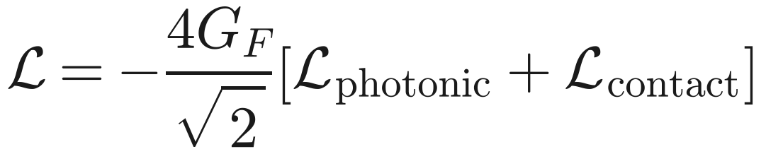
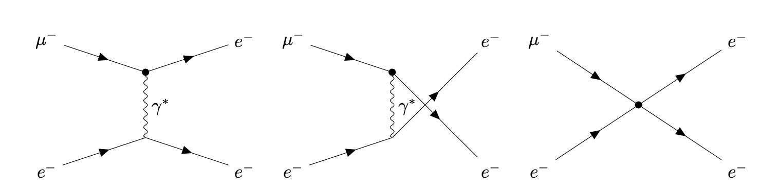
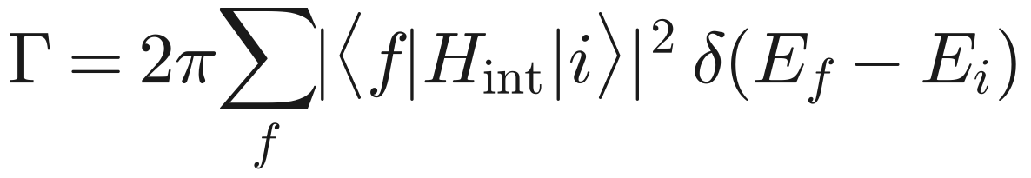
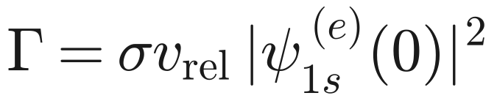
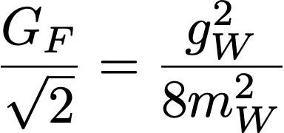
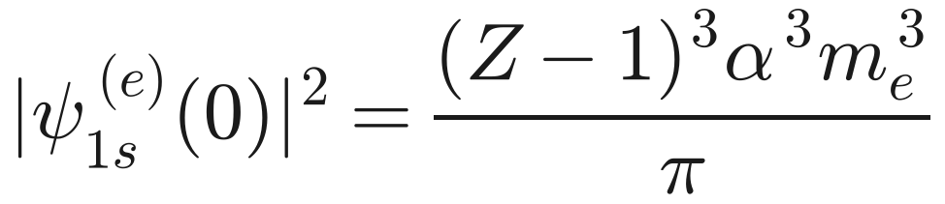
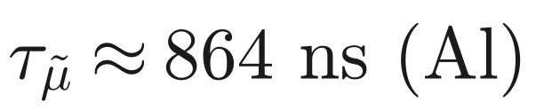
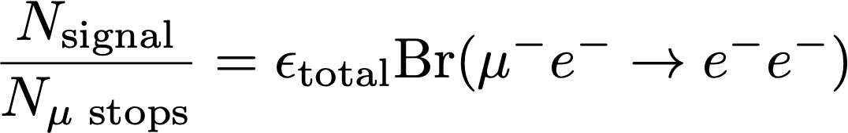
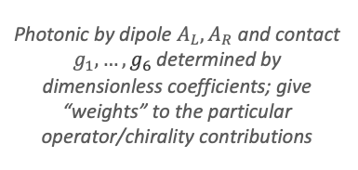
From Lagrangian to Branching Ratio, the $μ^{−}e^{−}→e^{−}e^{−}$ Process
Theory parameters become a rate, then a number Mu2e can count
Lagrangian
Amplitude
Rate
Branching ratio
General symmetry-allowed combinations of dimension-6 operators
via Feynman rules and operator contributions
via Fermi’s golden rule taken in nonrelativistic calculations
From process rate versus total decay time in a bound state
Dimension-six operators on account of the scaling by the square of the W boson mass squared
Branching ratio compares the rate of a preferred transition to the rate of all possible transitions. The rate of all possible transitions is just the lifetime.
Photonic by dipole $A_{L},A_{R}$ and contact $g_{1},…,g_{6}$ determined by dimensionless coefficients; give “weights” to the particular operator/chirality contributions
Appropriate general Feynman diagrams for photonic (above) and contact (below) type interactions for the process
Rate determined via interaction amplitude and phase space contributions.
Bound electron density at the muon, ∝ (Z−1)³ (Sargent’s Rule) and rate determined by Koike et al. and Uesaka et al.
Because muon lifetime differs based on if free or bound in an atom (varying based on what type of atom), the branching ratio can be determined as the decay rate x time
Feynman rules and appropriate operator contributions can be used to determine the invariant amplitude involving the Wilson Coefficients
Brivio & Trott [1]; Koike et al. [12]
Schwartz [2]; Koike et al. [12]
Griffiths [3]; Koike [12]; Uesaka [13]
Kuno & Okada [9]; Koike et al. [12]
Experimental relevance
(What does experiment tell?)
If a given process yields a number of signal events from a number of parents for the transition, the Branching ratio can be calculated by normalizing to the experimental efficiency
In Feldman Cousins techniques, less than 2.44 signal events required to claim a 90% confidence in no process observed
Feldman & Cousins [28]; Bernstein [17]
Notes:
Lagrangian -> Feynman rules -> amplitude; amplitude squared with Fermi golden rule -> rate; in the muonic atom Gamma = sigma v_rel |psi_1s(0)|^2 with |psi|^2 = (Z-1)^3 alpha^3 m_e^3 / pi (Koike et al. 2010); Br = tau Gamma; N_sig = N_stop eps Br; zero events gives Br < 2.44/(N_stop eps) at 90% CL (Feldman-Cousins).

Slide 10
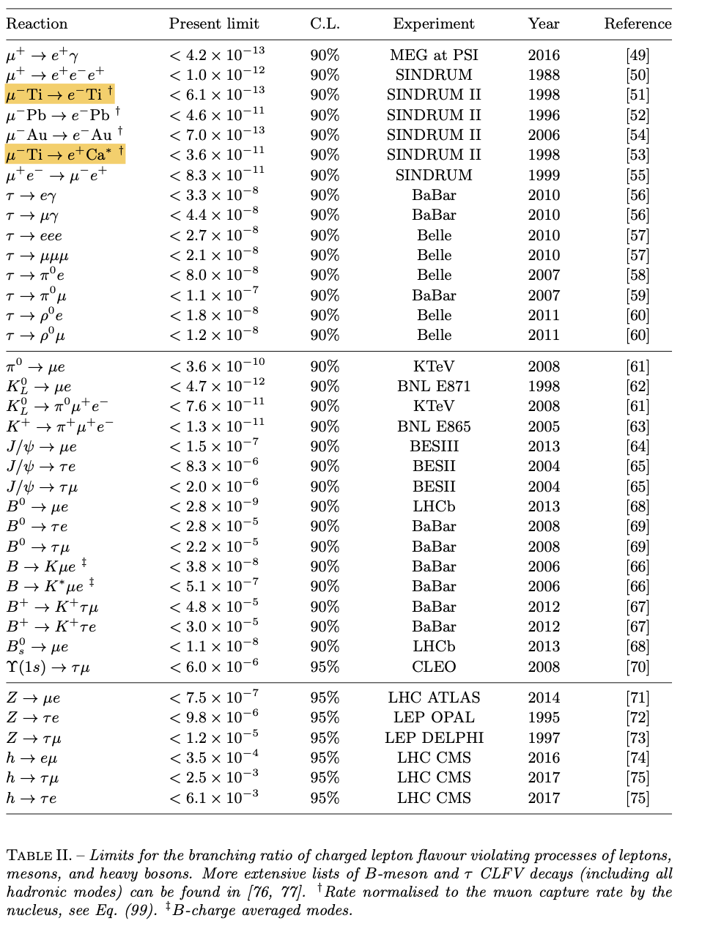
Current Limits Placed as Stated by Calibbi
Detailed list of all current limits placed by different experiments as of the Calibbi publication

Slide 11
Section 2 of 5
The Mu2e Experiment
1
Theoretical Motivation
Slides 3–11
Why search for charged lepton flavor violation?
2
The Mu2e Experiment
Slides 12–20
How does Mu2e isolate a single conversion electron?
3
Event Identification and Signal
Slides 21–26
What does μ⁻e⁻ → e⁻e⁻ look like in the detector?
4
Initial Investigation
Slides 27–35
What have I shown so far?
5
Goals and Deliverables
Slides 36–43
What will the dissertation deliver, and by when?

Slide 12

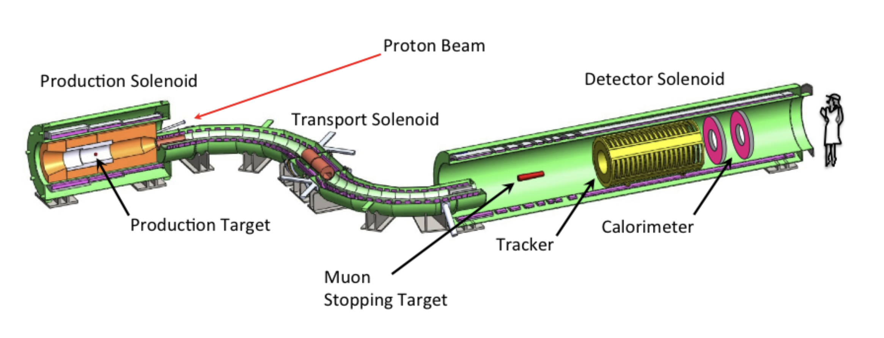
Primary Experimental Goals of the Mu2e Experiment
Detection of the coherent conversion of
K-shell conversion
Monoenergetic (104.973 MeV) single electron signature

Slide 13
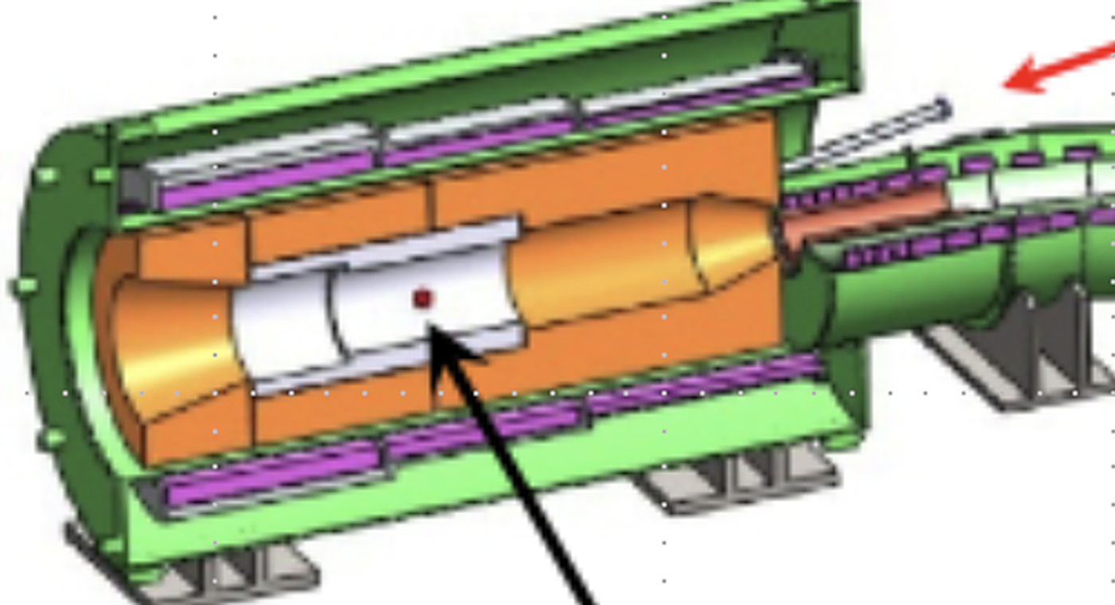
Production Target and Solenoid
Protons strike tungsten, and backward pions spiral toward the transport solenoid
Proton beam
Key points
8 GeV pulsed proton beam strikes a tungsten target
Graded field falls toward the transport solenoid
Backward pions spiral straight into the transport line
π⁺
π⁻
Production target
π⁻
π⁺

Slide 14
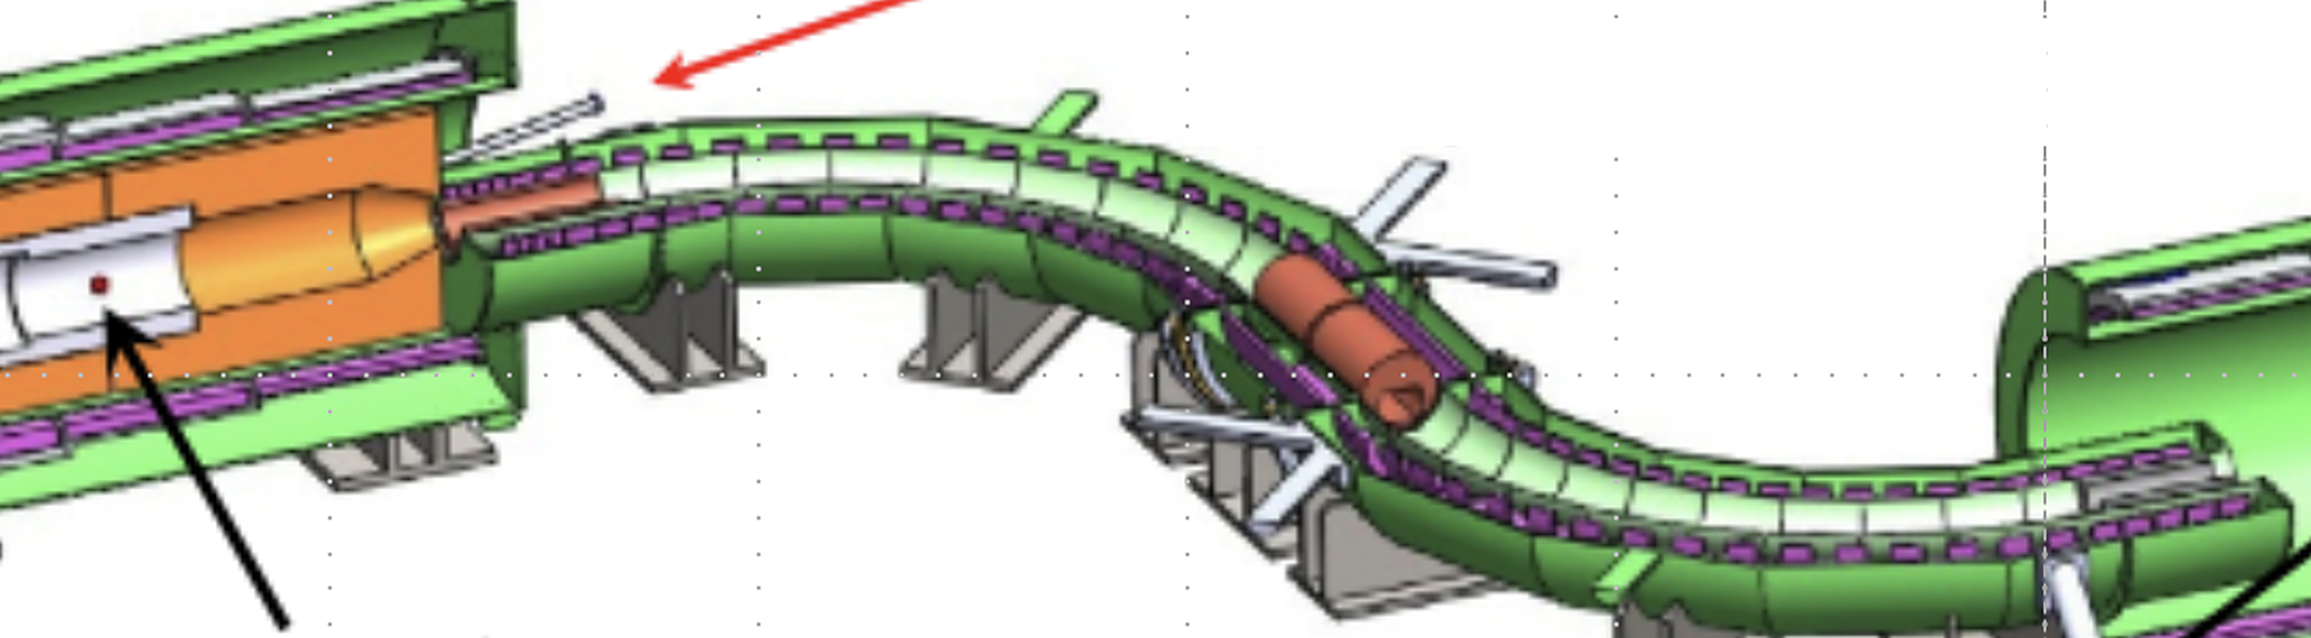



Transport Solenoid
The S-bend selects negative muons and blocks positive ones at the collimator
μ⁺ stopped at collimator
$$π^{+}→μ^{+}+ν_{μ}$$
$$π^{−}→μ^{−}+\overline{υ_{μ}}$$
S-shape removes line of sight from target to detector
Curved field drifts μ⁻ and μ⁺ in opposite vertical directions
Off-axis collimator passes low-momentum μ⁻ and blocks μ⁺
Thin window in the collimator absorbs antiprotons
$μ^{−}$ or $π^{−}$
$μ^{+}$ or $π^{+}$

Slide 15

Muon Stopping Target
Muons stop in the aluminum target, and a conversion electron leaves on a helix
Key points
Muons stop in thin annular aluminum foils
Captured μ⁻ cascades to the 1s orbit (τ ≈ 864 ns in Al)
Conversion electron leaves at 104.97 MeV
Field gradient guides electrons toward the tracker
e⁻
μ⁻
Stopping target
μ⁻
e⁻

Slide 16

Straw Tracker
The electron helix enters the annular straw tracker downstream of the target
Key points
18 stations, 20,736 straw tubes
80:20 Ar:CO₂ drift gas, ionized by passing electrons
Annular design lets low-momentum DIO electrons pass through the center
Half field doubles helix reach, so 52.8 MeV electrons hit the straws
e⁻
Stopping target
Tracker
e⁻

Slide 17

Electromagnetic Calorimeter
The electron exits the tracker and showers in the CsI disks
Key points
e⁻
Two annular disks of undoped CsI crystals
SiPMs read out the scintillation light
Measures energy, time, and position of each shower
Seeds track finding, separates e⁻ from μ⁻, and feeds the trigger
Shower in front calo disk
Tracker
e⁻ (inside tracker)
e⁻
Shower

Slide 18
Relevant Backgrounds and Mitigation Techniques
Beam timing, low-mass tracking, and a cosmic veto suppress each background; the two-electron signature adds more
Background | What it is | Mitigation in Mu2e | Extra handle for μ⁻e⁻ → e⁻e⁻
Muon decay-in-orbit (DIO) | Bound μ⁻ decays; nuclear recoil stretches the e⁻ spectrum toward 105 MeV | Precise momentum from a low-mass straw tracker in vacuum; annular tracker ignores low-momentum tracks | Spectrum peaks near 52.8 MeV, so reduce beam power; require two tracks, back-to-back, one vertex
Radiative muon capture (RMC) | μ⁻ capture emits a photon (endpoint ≈ 102 MeV in Al); γ → e⁺e⁻ | Aluminum target puts the photon endpoint below the conversion peak | Signal is a same-sign e⁻e⁻ pair; conversions give e⁺e⁻
Radiative pion capture (RPC) | π⁻ capture emits prompt photons up to ≈ 140 MeV | Pulsed beam with ≤ 10⁻¹⁰ extinction; live window opens about 700 ns after each pulse | Same timing protection
Beam flash | Prompt particles arriving with each proton pulse | Delayed live window, absorbers, and shielding | Same timing protection
Electromagnetic production | Photon conversions, Compton and delta-ray electrons in material | Minimal material; calorimeter E/p matching and track-quality cuts | Same-sign pair and common vertex reject e⁺e⁻ pairs
Cosmic-ray muons and byproducts | Cosmic μ decays or interacts in the detector hall, producing electrons | Cosmic Ray Veto scintillator around the detector; timing coincidence | A back-to-back pair from a target foil, not one through-going track
Reconstruction error | Mis-fit tracks and accidental hit combinations from pileup | KinKal fit quality and calorimeter matching | Common-vertex consistency (Goal 1)
Stopped muon
Beam-related
Other
Czarnecki et al. [16]; Bernstein [17]; Mu2e TDR [18]; Dukes & Ehrlich [23]; Brown [26]
Notes:
Timing: muonic Al lifetime 864 ns versus pion lifetime 26 ns, so a delayed live window removes prompt RPC and beam flash. Extinction between pulses must stay at or below 1e-10. RMC photon endpoint in Al sits near 102 MeV, below the 104.97 MeV conversion energy. At half field the DIO peak lands on the straws, which drives the beam-power reduction studied in Goal 2.

Slide 19
Section 3 of 5
Event Identification and Signal
1
Theoretical Motivation
Slides 3–11
Why search for charged lepton flavor violation?
2
The Mu2e Experiment
Slides 12–20
How does Mu2e isolate a single conversion electron?
3
Event Identification and Signal
Slides 21–26
What does μ⁻e⁻ → e⁻e⁻ look like in the detector?
4
Initial Investigation
Slides 27–35
What have I shown so far?
5
Goals and Deliverables
Slides 36–43
What will the dissertation deliver, and by when?

Slide 20




$μ⁻e⁻ → e⁻e⁻$ Signal Characteristics
Four characteristics differentiate this signal from decay-in-orbit and electromagnetic backgrounds
2 $e⁻$
52.8 MeV
$$≈ 180°$$
$$Δr, Δt ≈ 0$$
Two electron tracks
Each electron carries ≈ m_{μ}/2
Back-to-back emission
Common origin
Same-sign pair; photon conversions and pair production give e⁺e⁻
Sits at the Michel peak, so energy alone cannot reject DIO
Opening angle near 180° in the muon rest frame
Both tracks start at one point and one time on a foil
Event display (MC truth): both electrons leave one stopping-target foil. The upstream electron reflects off the field gradient and turns toward the tracker and calorimeter.

Slide 21

Experimental Configuration Requirements
Seeing both 52.8 MeV electrons takes three changes to the standard Mu2e run
1
Half-strength detector solenoid
2
Reduced proton beam power
3
Multi-track trigger
STANDARD MU2E
THIS CHANNEL
STANDARD MU2E
THIS CHANNEL
STANDARD MU2E
THIS CHANNEL
1.0 T at Peak
0.5 T at Peak
Full intensity
Reduced
One 104.973 MeV e⁻
Two $≈$52.8 MeV e⁻
Why
Why
Why
At full field, 52.8 MeV the helical path curves inside the tracker annulus. Half field doubles the helix radius so they reach the straws, and the field gradient still mirrors upstream electrons.
Half field also puts the DIO peak on the straws. Lower beam power limits pileup in reconstruction, and electronics dead time. Goal 2 simulations set the exact reduction.
The standard trigger selects a single conversion electron. A dedicated trigger, built with the Mu2e trigger group, keeps two-electron events.
Notes:
Field values refer to the detector solenoid at the tracker: nominal 1 T, half field 0.5 T. Helix radius scales as p_T/(0.3 B), so halving B doubles the radius of a 52.8 MeV electron, matching a 105 MeV electron at full field. Beam-power reduction fraction remains to be determined in simulation.

Slide 22
Section 4 of 5
Initial Investigation
1
Theoretical Motivation
Slides 3–11
Why search for charged lepton flavor violation?
2
The Mu2e Experiment
Slides 12–20
How does Mu2e isolate a single conversion electron?
3
Event Identification and Signal
Slides 21–26
What does μ⁻e⁻ → e⁻e⁻ look like in the detector?
4
Initial Investigation
Slides 27–35
What have I shown so far?
5
Goals and Deliverables
Slides 36–43
What will the dissertation deliver, and by when?

Slide 23


Toy-Generator Creation and Validation
B2BCeEndpoint throws two back-to-back 52.8 MeV electrons from each stopped muon
1
Initialize the generator
FHiCL inputs: stopping target material, particle PDG code, verbosity
Custom art::EDProducer module, configured through FHiCL
2
Select a parent muon
Input: SimParticleCollection of stopped μ⁻
Draw one μ⁻ stopped in the Al target
3
Sample the decay time
Exponential in the material-dependent lifetime τ_{μ}
4
Assign the electron energies
Two daughter electrons share the muon rest energy
5
Throw the momenta
Direction n̂ drawn uniformly from the unit sphere
6
Build four-vectors and store
Saved with PDG, process code, parent muon, origin time
Hand-off: Geant4 Monte Carlo steps → Digitization → Reconstruction → Ntuple
Notes:
LaTeX for native PowerPoint equations (Insert > Equation > LaTeX):
3: f(\Delta t)=\frac{1}{\tau_\mu} e^{-\Delta t/\tau_\mu}
4: E_1=E_2=\frac{m_\mu}{2}\approx 52.8\ \mathrm{MeV}
5: |\mathbf{p}|=\sqrt{E_i^2-m_e^2},\ \mathbf{p}_1=|\mathbf{p}|\hat{n},\ \mathbf{p}_2=-|\mathbf{p}|\hat{n}
6: p_1^\mu=(E_1,\mathbf{p}_1),\ p_2^\mu=(E_2,\mathbf{p}_2),\ \mathbf{p}_1=-\mathbf{p}_2

Slide 24






Toy-Generator Creation and Validation
Truth-level checks confirm each generator step behaves as intended
Momentum check
Isotropy check
Back-to-back check
Expected
Expected
Expected
$|p|≈52.8$ MeV/c for every electron
Flat in $\cos{θ}$and $φ$, since $\hat{n}$ is uniform on the unit sphere
$θ_{2}=π−θ1$, since $p1=−p2$
Result
Result
Result
One sharp peak at 52.8 MeV/c: 200,000 tracks from 100,000 events
Uniform population across the full solid angle
Every entry lies on one line of slope −1

Slide 25
Analysis Products Produced from Muon Stops
The standard Mu2e workflow carries 100,000 generated events (from stops) to analyzable ntuples
Muon stops
Primary generation
Digitization
Reconstruction
Ntuple
Stopped μ⁻ in the aluminum target, read from the standard stops file
Generator throws the electrons. Geant4 steps them through fields and material.
Digital twin converts straw and crystal hits into expected electronic signals
Kinematic Kalman (KinKal) fit turns digis into helical track parameters
Packages analysis-relevant information from reconstruction with Monte Carlo truth for ROOT analysis
Output
Stopped μ⁻ SimParticleCollection
Output
SimParticles and step points
(dts.__.art file)
Output
Straw and calorimeter digis
(digi.__.art file)
Output
Fitted tracks and relevant digis
(mcs.__.art)
Output
ROOT ntuple with necessary info
(nts.__.root)
Events surviving each stage (pure-signal sample)
Feeds the selection cuts on slide 32
100,000
66,545
50,792
50,792
100.0%
66.5%
50.8%
50.8%
Notes:
Survival numbers from Table 2 of the proposal: 100,000 stops, 66,545 surviving primaries, 50,792 after digitization, 50,792 after reconstruction. The drop at primary generation reflects geometric acceptance; digitization removes events without enough detector hits. Reconstruction keeps every digitized event at this stage. Selection cuts follow on slide 32.

Slide 26


Event display depicting two electron track (MC truth) helicies moving from stopping target foil through the detector system. Notable feature being the magnetic mirror effect demonstrated from the backwards moving electron
Surviving Monte Carlo truth generated particle momenta post full sim-workflow. This shows that only a selection of the generated electrons will be able to be seen in the detector given the geometric acceptance and reconstruction capabilities.

Slide 27
Candidacy Cuts for Vertexing Procedure
Three cuts keep 16,771 clean two-electron candidates from 100,000 muon stops
Cut 1
Stage | Events | % of stops | Kept from previous
Muon stops | 100,000 | 100.0% | —
Surviving primaries | 66,545 | 66.5% | 66.5%
Digitization | 50,792 | 50.8% | 76.3%
Reconstruction | 50,792 | 50.8% | 100.0%
Cut 1: Exactly two tracks | 31,221 | 31.2% | 61.5%
Cut 2: Good calo hit (both) | 23,253 | 23.3% | 74.5%
Cut 3: Momentum window | 16,771 | 16.8% | 72.1%
Final candidates | 16,771 | 16.8%
1
Exactly two electron tracks
Fewer than two tracks look like decay-in-orbit; more are rare in a pure sample
2
Cut 2
Good calorimeter hit on both tracks
Confirms each track and seeds the fit; a candidate cut to relax for acceptance
3
Cut 3
Momentum window: 50 ≤ |p| ≤ 53 MeV/c
Brackets 52.8 MeV/c while allowing energy loss in material
Pure-signal sample: 100,000 μ⁻e⁻ → e⁻e⁻ events thrown from muon stops
Notes:
Simulation stages (gray) come from geometric acceptance and detector response. The three analysis cuts (shaded) take 50,792 reconstructed events to 16,771 candidates, keeping 33.0% of reconstructed events. The calorimeter cut is the most open to relaxation for higher acceptance.

Slide 28

Reconstructed Momentum Cut Progression
The momentum window keeps the reconstructed peak and drops the energy-loss tail
Cut 3 window
How to read it
MC truth, generated e⁻
All reconstructed e⁻
Cut 1: exactly two tracks
Cut 2: + good calo hit
Cut 3: + 50 ≤ p ≤ 53 MeV/c
Takeaways
Truth sits in a single bin at 52.8 MeV/c
Reconstructed tracks peak just below it, shifted by energy loss in material
Cuts 1 and 2 lower the spectrum without shifting the peak
Cut 3 removes the low-momentum tail
Log scale: tracks per bin
Notes:
Colors follow the ROOT plot. Truth is a single spike at m_mu/2. The reconstructed peak sits slightly below because electrons lose energy crossing the stopping-target foils and tracker material, which also builds the long low-momentum tail. The 50 to 53 MeV/c window keeps the peak and removes the tail.

Slide 29

Initial Vertexing Procedure for Finding a Common Origin Position (Part 1)
Each track becomes a straight line through its stopping-foil intersection
Inputs from the ntuple
1
Parameterize each track as a line
Track segments store an intersection position $\overset{⃑}{r_{0}}$ and momentum $\overset{⃑}{p}$ at each surface through which the reconstruction parameterization passes
Keep the stopping foil both tracks intersect
Several shared foils: take the smallest time separation
Unit direction: $\hat{p_{i}}=\frac{\overset{⃑}{p_{i}}}{\left|\overset{⃑}{p_{i}}\right|}$
$s$ and $t$ carry units of length (mm), since $\hat{p_{i}}$is unitless
2
Build the separation vector
3
Squared distance to minimize
Notes:
F is minimized instead of |D| because |D| is non-negative, so both share the same minimum and F avoids the square root.

Slide 30


Initial Vertexing Procedure for Finding a Common Origin Position (Part 2)
The vertex sits at the midpoint of the two lines’ closest approach
Set the gradient to zero
1
Two linear equations in s and t
Solve for s* and t*
2
Shorthand a and d keeps the result compact
Distance of closest approach
3
Small D* means the tracks share an origin
Reconstructed vertex
4
Midpoint of the closest-approach segment
Notes:
Full forms: s* = [(w0·p1) − (p1·p2)(w0·p2)] / [1 − (p1·p2)^2], t* = [(w0·p1)(p1·p2) − (w0·p2)] / [1 − (p1·p2)^2]. Note the denominator 1 − a^2 vanishes when the two directions are parallel or antiparallel (a = ±1); near back-to-back directions make the solution numerically sensitive. The vertex is the midpoint r_V = (r1* + r2*)/2, with the plus sign.

Slide 31









Vertexing Algorithm
The vertex is the midpoint of the closest-approach segment between the two track lines
Selected Target Foil
$\overset{⃑}{r_{1}}(s^{∗})$
$\overset{⃑}{p_{1}}$ $=(p_{1x},p_{1y},p_{1z})$
$$\overset{⃑}{r_{𝒱}}$$
$\overset{⃑}{r_{1}}(s)$
$\overset{⃑}{p_{2}}$ $=(p_{2x},p_{2y},p_{2z})$
$\overset{⃑}{r_{1,0}}$ $=(r_{1x},r_{1y},r_{1z})$
$\overset{⃑}{r_{2}}(t^{∗})$
$\overset{⃑}{r_{2}}(t)$
$\overset{⃑}{r_{2,0}}$ $=(r_{2x},r_{2y},r_{2z})$
Detector Origin

Slide 32

Reconstructed Vertex Position
Most reconstructed vertices fall inside the stopping target
What the plots show
x–y: vertices cluster within the target radius
x–z: vertices fill the full foil stack along z
The inner hole and the gaps between foils are not resolved
A sparse halo of vertices falls outside the target
x–y view
x–z view
Red boxes: stopping-target extent in each projection

Slide 33





Vertex Resolution versus Monte Carlo Truth
x and y resolve well, while z drives the total residual
Δx (reco − truth)
$μ=0.23 σ=63.6$mm
Δy (reco − truth)
μ = −1.92 σ = 61.1 mm
Why z lags
x and y: narrow peaks centered near zero
z: offset by +84 mm with a long positive tail
Straight lines ignore helix curvature, which hits z hardest
Near back-to-back pairs make 1 − a² small and destabilize s*, t*
Next: helical, covariance-aware vertexing (Goal 1)
Δz (reco − truth)
μ = 84.4 σ = 288.6 mm
|Δr| (distance to truth)
μ = 239.4 σ = 197.6 mm
7,640 vertices compared to MC truth

Slide 34
Section 5 of 5
Goals and Deliverables
1
Theoretical Motivation
Slides 3–11
Why search for charged lepton flavor violation?
2
The Mu2e Experiment
Slides 12–20
How does Mu2e isolate a single conversion electron?
3
Event Identification and Signal
Slides 21–26
What does μ⁻e⁻ → e⁻e⁻ look like in the detector?
4
Initial Investigation
Slides 27–35
What have I shown so far?
5
Goals and Deliverables
Slides 36–43
What will the dissertation deliver, and by when?

Slide 35

Goals and Deliverables
Four goals build toward one reconstruction-level sensitivity result by Winter 2028
Fall 2026
Spring 2027
Summer 2027
Fall 2027
Spring 2028
Summer 2028
Fall–Winter 2028
1
Vertexing Update
Develop improved vertexer and integrate into Mu2e Computing/Offline workflow
Goal 1
2
Background Mixing
Production team assisted mixing of relevant backgrounds for the $μ^{−}e^{−}→e^{−}e^{−}$ process with signal
Goal 2
3
Theory-Weighted Generator
Implement differential templates calculated by Sudheer Muhammad
Goal 3
4
Sensitivity Study
Full statistical analysis and exp. requirements predicted
Goal 4
D
Dissertation
Write and defend
Final goal
Dissertation defense
Goal 3 feeds updated signal into the Goal 2 samples. All goals converge in Goal 4. Final deliverables: dissertation, short paper, and internal Mu2e note.
Proposal defense, Oct 2026

Slide 36
1
Helical Common-Vertex Reconstruction
Goal 1 of 4 | Fall 2026 to Summer 2027
NOW
TARGET
Straight-line closest approach and midpoint estimate
Covariance-aware helical vertex from reconstruction-level track fits
Approach
Deliverables
1
Replace straight lines with the fitted helical trajectories of both tracks
Analyzable reconstructed-track and helix data product
2
Use full track-fit information: position, direction, time, and covariance
Covariance-aware common-vertexing module
Quantify vertex quality: closest approach, residuals, fit quality, bias, resolution
Vertex position, time, quality, and uncertainty
3
Monte Carlo truth validation in the Mu2e art/FHiCL workflow
4
Validate against Monte Carlo truth across the signal kinematics
Vertex-quality variables for background discrimination
5
Integrate into the Mu2e workflow, reusable for any multi-body final state
Write-ups
6
Use common-vertex consistency to reject accidental pairs and backgrounds
Technical paper on the vertexing implementation
Internal Mu2e note on using the vertexer

Slide 37
2
Signal–Background Mixing
Goal 2 of 4 | Spring 2027 to Spring 2028
NOW
TARGET
Reconstructed signal-only samples and preliminary characterization
Production-supported mixed samples with validated discrimination
Approach
Deliverables
1
Define overlay samples with the production team, including realistic pileup
Analyzable pure-signal and mixed simulation samples
2
Study DIO, cosmic-ray, RPC/RMC, and beam backgrounds alone, then overlay and scale
Reconstructed DIO, cosmic-ray, RPC/RMC, and beam-related samples
3
Measure DIO pileup at half field to set the required beam-intensity reduction
Occupancy, pileup, and combinatoric characterization
4
Quantify occupancy and combinatoric effects on tracking, vertexing, and efficiency
Robust signal–background track discrimination
5
Characterize backgrounds with kinematics, timing, vertex consistency, calorimeter, and CRV
Validated background yields, efficiency, and systematic inputs
6
Configure the multi-track trigger with the Mu2e trigger group
Feed background yields, efficiency, and systematics into the sensitivity
Write-ups
7
Proposal to Mu2e for dedicated half-field running

Slide 38
3
Theoretical Refinement of the Generator
Goal 3 of 4 | Fall 2027 to Spring 2028
NOW
TARGET
Toy generator: equal-energy, isotropic, exactly back-to-back electrons
Theory-weighted, recoil-aware generator with correlated energy and angle
Approach
Deliverables
1
Replace toy kinematics with theory-derived energy and opening-angle distributions
Theory-weighted μ⁻e⁻ → e⁻e⁻ event generator
2
Weight photonic and contact interactions by their relative probabilities
Correlated electron-energy and opening-angle distributions
Bound-state effects and aluminum nuclear recoil
3
Include muonic-aluminum bound-state effects and nuclear recoil (Z = 13)
Kinematic validation against theory
4
Implement in Mu2e Offline with a reproducible, high-statistics workflow
High-statistics reconstructed signal samples
Updated mixed samples with the refined signal model
5
Validate at truth level against conservation laws and published predictions
Write-ups
6
Propagate to acceptance, efficiency, vertexing, discrimination, and sensitivity
Technical paper with S. Muhammad and A. Petrov
Internal Mu2e note on the generator and its sampling
Differential templates from S. Muhammad and A. Petrov (USC theory)

Slide 39
4
Full Sensitivity Study and Statistical Analysis
Goal 4 of 4 | Summer 2028 to Winter 2028
NOW
TARGET
Back-of-envelope run-time estimate from simplified assumptions
Expected limit and discovery reach, with the Mu2e running conditions they require
Approach
Deliverables
1
Validate geometry, fields, trigger, digitization, and reconstruction for total efficiency
Signal-efficiency and background-yield model
2
Combine generator, vertexing, and mixed backgrounds into one yield model
Poisson and Feldman–Cousins analysis toolbox
Optimize proton beam intensity against pileup and statistics
Expected upper limit and discovery reach
3
Systematic-uncertainty evaluation
4
Feldman–Cousins: upper limits for null results, two-sided intervals for a signal
Required beam intensity, POT, and run duration
5
Use Poisson likelihoods; separate limits from 3σ and 5σ discovery reach
Final reconstruction-level Mu2e sensitivity
6
Evaluate systematics: signal model, efficiency, background, normalization
Write-ups
Find the stopped muons, POT, and wall-clock time to surpass SINDRUM
Formal request for half-field run configuration
7
Internal Mu2e note on analyzing this channel

Slide 40
Summary
Mu2e has the capability to search for an additional $∆L_{μ}=1$CLFV channel, and initial renditions of the required tools are already promising
IMPORTANCE OF STUDY
PROMISING INITIAL INVESTIGATION
UPCOMING PROGRESS IN RESEARCH
A clean, untested window on charged lepton flavor violation in an already active experimental design
The Mu2e simulation environment allows for a study to be progressed
Four goals to complete a reconstruction-level sensitivity study
≈ 1 Month
≈16.8%
1
Helical, covariance-aware vertexing
Lepton flavor is an accidental symmetry of the Standard Model
Neutrinos change flavor; have not seen charged leptons do the same
Current B.R. limit near 10⁻¹², inferred only by crossing from SINDRUM (1988)
Additional models, operators, and mediators to constrain if run
Signature: two back-to-back 52.8 MeV electrons from one vertex
Wall-clock hours required to improve constraint from back-of-envelope calc.
Simulation efficiency from candidacy cuts of pure-signal generation
2
Signal–background mixing at half field
Toy back-to-back generator built and validated in Mu2e Offline
Simulation from stops through ntuples, with three candidacy cuts for vertexing process
Initial common vertex process utilized; minimization of z residual is the next target
3
Theory-weighted generator with nuclear recoil implemented in generator sampling
4
Full sensitivity and required run conditions determined for optimal sensitivity
Dissertation defense: Winter 2028
This study will tell Mu2e whether a dedicated half-field run can push $μ⁻e⁻ → e⁻e⁻$beyond the SINDRUM-era limit, what that run costs in beam time, and optimal run settings to identify upcoming sensitivity if beam time is approved.
Notes:
Close on the conclusion band: the deliverable is a decision tool for the collaboration. Numbers: 16,771 of 100,000 stops survive (16.8%); vertex resolution sigma 63.6 mm in x, 61.1 mm in y, 288.6 mm in z. Current mu- e- -> e- e- limit of 1.0e-12 is inferred by crossing symmetry from SINDRUM mu+ -> e+ e- e+ (1988).

Slide 41
Thank you

Slide 42

THANK YOU
Backup slides
Questions?
Geometric vertexing derivation
Muon lifetime considerations
Wall-clock hours estimate
Magnetic mirror derivation
A dedicated reduced-field run could push $μ⁻e⁻ → e⁻e⁻$beyond the SINDRUM-era limit. This study will determine optimal run conditions and what improvements the Mu2e experiment can make in what amount of run time.
Half-field detector solenoid requirement
Effective Lagrangian for μ⁻e⁻ → e⁻e⁻
Mu2e detector, component by component
References
With thanks to Dr. Dave Tedeschi, Dr. Bertrand Echenard, Dr. Alexey Petrov, Sudheer Muhammad, the committee, and the Mu2e Collaboration members who have assisted me in various goals throughout the process thus far.
Andrew Boldy | University of South Carolina | Mu2e Collaboration

Slide 43
Backup Slides

Slide 44
Geometric Vertexing Description
Geometric Vertexing Description and Derivation

Slide 45
Muon-Lifetime Considerations
Muon Lifetime Consideration and Calculation

Slide 46



Back-of-Envelope Wall Clock Hours Prediction (Pt. 1)
Number of signal events needed:
Live time required:
Useful parents being stopped muons means we can determine the rate of the stopped muons from:
Live time in quantities of the beam ($P=R_{POT}×E_{p}$), stops, and efficiency
Note that efficiency ($ε$) is comprised of multiple different efficiencies multiplied together: found via simulation

Slide 47


Back-of-Envelope Wall Clock Hours Prediction (Pt. 2)
Values to use in the calculation:
  $P=1.5$ kW (Bernstein, 2019 Frontiers), needs to be reduced by large factor (300) for pileup considerations in reconstruction → exact to be determined
  $E_{p}=8$ GeV
  $N_{stops}={10}^{18} μ$
  $N_{POT}=3.8×{10}^{20}$ protons
  $Br\left(μ^{−}e^{−}→e^{−}e^{−}\right)=1.0×{10}^{−12}$ branching ratio from Sindrum II analogous process
  From initial simulation, efficiency from muon stops to ntuple stage $ε≈9.54\%$ (estimate)
  For 90% confidence interval: $N_{signal}=2.3$ events → 648.94 hours $≈$ 27.04 days
  For 95% confidence interval: $N_{signal}=3$ events→ 846.45 hours $≈$ 35.27 days
  For 99% confidence interval: $N_{signal}=4.6$ events → 1,297.89 hours $≈$ 54.08 days

Slide 48

Magnetic Mirror Effect Derivation (Pt. 1)
Assumptions
  static magnetic field (${dB}/{dt}=0$) with no external electric field $\overset{⃑}{E}=0$
  Nonrelativistic motion ($v≪c$) for particles moving in field
  Magnetic field assumed to be solely in $z$-direction, $\overset{⃑}{B}=B(z)\hat{z}$ and changes gradually with change in $z$

Slide 49
Half-Field DS Field Designation
Half-Field DS Field Necessity Derivation

Slide 50
Mu2e Experiment Background Slides

Slide 51


Proton Beam
Utilize the Fermilab Delivery Ring to supply a stream of 8 GeV protons in a time-pulsed format
  Pulse width: 250 ns FWHM
  Pulse separation: 1,695 ns
Anticipated Protons on Target (POT): $3.6 × {10}^{20}$ protons
Notes:
This proton beam will be utilizing the Fermilab Delivery Ring to supply a stream of 8 GeV kinetic energy protons in a time-pulsed format. This pulse will have a Full width half max of 250 ns and a separation of 1,695 ns for reasons that will be discussed a little later.
A quick sneak peak into why we will be discussing these things is in this diagram. Notice how the selection window for events exists between these pulses. This is part of the inginuity of the Mu2e experiment in its intensity of muon beams and its avoidance of backgrounds.
the anticipated protons on target is 3.6 x 10 to the 20

Slide 52


Production Target and Solenoid
Radiatively cooled tungsten solid target
Production of pions that scatter backwards
Charged pions decay into (anti-)muons and muon (anti-)neutrino via the diagrams below
Solenoid focuses pions into transport solenoid
Magnetic field density plot of production solenoid (top)
Magnetic flux along magnet axis (bottom);
from the Conceptual Design of Mu2e Production Solenoid
put out by Kashikhin et al.
Hand-drawn diagrams for pion decay modeled after diagram in
Intro. to Particle Physics by Griffiths
Notes:
the production target is a radiatively cooled solid tungsten target.
upon collision with the target, the protons cause a process to produce pions that scatter backwards and begin to travel further down the experimental path
all types of pions can be scattered, and specifically the pions of interest are the negative ones. pions decay into muons and neutrinos according to the diagrams below and these are what will propagate into the next component
here is an image of the magnetic field density of the solenoid and the flux along the field axis from the Production Solenoid conceptual design

Slide 53


Transport Solenoid
S-shaped structure serves three major functions
  Allows for the selection of $μ^{−}$ vs $μ^{+}$
    Vertical deviation from the path differs between positive and negative charges
      Particle drift in solenoidal field → Jackson E&M Problem 5.2
    Orient magnetic fields to only allow negative muons from the $π^{−}$ decays
  Prevents the accumulation of photons created from proton collision
    Uncharged particles without moments do not bend in presence of magnetic field
    go directly into the wall of the solenoid at bend
  Particles with too large a momentum will hit solenoid walls and not make it into the detector
    too large a radius of gyration $r={p_{⊥}}/{0.3B}$
    also true for a straight solenoid, but exaggerated effects in the S shape
Installed Transport Solenoid in the Mu2e Pit
from the status updated published by Stefano Miscetti
and the Mu2e Collaboration (2025)
Notes:
So, what is the reason for this S shape? there are in fact three major functions
the first is that it allows for selection of muon vs anti muon going in the direction of the detector
vertical deviation from the path differs between positive and negative charges and there is a vertical deviation from the path on account of particle drift in the solenoidal field, something that is mentioned in a problem in Jacksons classical electromagnetism text
Next is that is prevents the accumulation of energetic photons that may alter the signals or cause undue firings of photomultipliers -- since they are uncharged they do not bend in the presence of a magnetic field and go directly into the wall of the solenoid at the bend
Finally, it acts a momentum selector (of sorts), as particles with too large a momentum will hit the solenoid walls and not make it into the detector system. this is due to the increase of perpendicular component of momentum adjusting the radial motion of the particle in the magnetic field (radius of gyration)
Here is a recent image of the fully installed transport solenoid in the Mu2e pit at Fermilab

Slide 54


Stopping Target
Inside the stopping target, the muon knocks out an electron bound to an aluminum atom and sits in the k-shell
  the K shell is the innermost nuclear shell of an atom, containing only an s-orbital
  being at $n=1$, it can only have 2 spin ½ particles in it
  Increase in the mass of the orbiting lepton draws the radius of this atom in closer to the nucleus (smaller Bohr radius if it were a hydrogen atom)
  Aluminum nucleus has $Z=13$
168 grams of 99.99% aluminum
Annular construction: minimize damage of stopping target as products pass to beam dump
Muons sit in the potential of the aluminum nucleus and decay after a lifetime of $τ_{μ}=864$ ns (compared to the 2.2 $μ$s lifetime of a free muon)
  electrons produced during this decay are monoenergetic with a conversion signature of $E_{CE}=104.97$ MeV
Simulated electron production for a mixed signal dataset constructed using
Geant4 simulation in Mu2e Geometry. Shaded region is the stopping target
Notes:
The muon travels and kicks out an electron bound to the aluminum atom and finds rest inside the n=1 or K shell. The K shell, not having any orbitals except the single s orbital can only hold two spin 1/2 particles. An interesting calculation one could do here is look at what would happen to the Bohr radius at the ground level of the hydrogen atom in this situation. It happens that the Borh radius could actually have a probability of overlapping with the nuclear radius itself.
The Aluminum is much larger than a hydrogen atom sitting at a Z of 13, and neutrons included to boot, but this aluminum is well equipped to help us stud the effects we are looking for, being 168 grams, its lightweight and can be suspended and it has an annular construction so as to minimize the damage of the stopping targets as products pass to the beam dump
this is an image of electron origin positions plotted using ROOT from mixed process Geant4 Simulation files utilizing the Mu2e geometry. The shaded region with high frequency is the stopping target.
muons in the potential of the aluminum nucleus have a much shorter lifetime, sitting at only aroud 864 ns compared to the 2.2 microsecond for a free muon. Further, electrons produced by this reaction (called conversion electrons) are monoenergetic, producing a signature of 104.973 MeV

Slide 55

Tracker
Small Black Circle: Michel Electrons
Larger Black Circle: Intermediate Momentum
Green Circle: Conversion electron
18 tiers of the tracker centered along the beam axis
  each tier has 2 planes rotated 30 degrees between each other
  each contains array of straw tubes filled with 80:20 split of argon:CO2 gas for the drift gas
    when a charged particle passes through the gas, the gas ionizes, creating a voltage difference measurable by the electronics of the system
    total of 20,736 straw tubes
Allows for the determining of path by following the discharge of straws during each detected event
  eventually (in conjunction with the next apparatus) allows for reconstruction of the path taken by each event particle
Small resolution and minimum energy loss decreases effect of DIO
Figure showing a side profile of the arrangement of detector plates, and the breakdown
of different locations where electrons may intersect when moving through the detector;
Bernstein 2019
Notes:
The tracker is comprised of 18 separate tiers each with 2 planes offset by an angle of 30 degrees containing a number of straw tubes.
These straw tubes function by the ionization of an inert gas (argon and CO2 mixture) which then sends a signal to the electronics of the system letting the system know a particle has now passed through it. After passing through the system the trajectories can be determined by coincidence of signals from the various straws. This allows us to reconstruct the path and analyze it, along with the next component
Small energy resolution and minimum losses allow us to decrease the effect of a particularly detrimental background called Decay in Orbit (DIO) which we will come back to
here is an image that shows that detector plates construction with some acceptance regions shown for various momenta electrons passing through. Note how the michel electrons (those that go like the Standard Model decay, are not incident on the straws, while the green circle shows the conversion electrons are)

Slide 56

Calorimeter
Constructed from undoped CsI crystals
  Very prominent scintillator in particle physics on account of its specific wavelength emitted
  Light taken in by photosensors (Silicon Photomultiplier, SiPMs)
  Converted to signal read in by DAQ
  Annular construction: minimize damage of detector systems as products pass to beam dump
Two disk system to make sure helices of conversion electrons are not missed (separation of approximately 1 wavelength of the helix)
Purpose: Particle identification
  differentiation between electrons and muons by mass difference
    electrons cause radiative “showers”, muons are heavier and do not radiate as much
Purpose: Improvement of track reconstruction
  “seed” for reconstruction: start at calorimeter and work backwards to decrease computation time. Mark out hits in the calorimeter crystal clusters first
  consistency check: making sure the tracks line up in a possible fit (Kinematic Kalman Fit)
  can reconstruct position/direction of shower, time of hit, and energy deposited by the shower of particles that hit the calorimeter
Purpose: Triggering
  specific energy ranges on the shower can choose what data to store and where, as we have a monoenergetic signal electron
Calorimeter diagram with the annulus and the two disk orientation
from Bernstein (2019)
Notes:
the calo is constructed from undoped cesium iodide crystals which are a very prominent scintillating material in particle physics on account of its wavelength and versatility. Light from the scintillators is taken in and amplified by the Silicon photomultiplier tubes and then converted to a signal read in from DAQ.
The two disk system with spacing of about one half helix wavelength allows us to make sure the helicies do not miss one of the plates before heading to the beam dump
This purpose is three-fold. First for identification of particles on account of the radiative showering difference between electrons and muons (and other particle). Next is the improvement of track reconstruction. If we want to decrease the computational power needed, its easiest to start where the electron ended and work backwards to give us our fits. Thirdly it allows us to have an energy trigger which is very important for this specific reaction.
here is an image of the calorimeter in its mockup diagram

Slide 57




Effective Lagrangian Description of the $μ^{−}e^{−}→e^{−}e^{−}$ Process
The low energy CLFV interaction can be parameterized by dimension-six effective Lagrangian containing photonic dipole terms and four-lepton contact terms.
Photonic Lagrangian: tensor vertex coupled with photonic field with distinct chiral structures
Contact Lagrangian: scalar and vector structures, four-point interaction with distinct chiral structures

Slide 58

Toy-Generator Creation and Validation
Dedicated Mu2e art/FHiCL signal-generator module for the process of interest
  Implemented as an instance of the EDProducer class
Models a stopped μ⁻ in the aluminum stopping target, with both generated electrons originating from a common position and time.
Generates two on-shell electrons with equal energies $E_{1}=E_{2}=\frac{m_{μ}}{2}$as controlled benchmark
Samples one isotropic direction over the full solid angle and assigns exactly opposite three-momenta with $\overset{⃑}{p_{1}}=−\overset{⃑}{p_{2}}$
Enforces equal momentum magnitudes and a back-to-back opening angle, $\cos{θ_{12}=−1}$, providing a simple, well-defined two-electron signal topology.
Validated at generator level through angular isotropy, momentum equality, opening-angle, and energy–momentum-conservation checks.
Propagated through the Mu2e simulation chain:
generation → Geant4 transport → digitization → reconstruction → analysis ntuples.
Serves as a deliberately simplified validation model; later work will introduce theory-weighted energy/angular distributions bound-state effects, and aluminum nuclear recoil.

Slide 59
Improvements to Vertexing Procedure
Current: Preliminary geometric line–line closest-approach and midpoint estimate
Replace the preliminary straight-line geometric estimate with a common-vertex reconstruction based on the fitted helical trajectories of both reconstructed electron tracks.
Use full reconstructed-track information utilizing position, momentum/direction, time, and fit covariance from Mu2e track-fit products rather than only intersection position and direction estimates.
Quantify vertex quality and uncertainty using the track-pair distance of closest approach, vertex residuals, fit quality, bias, and spatial/time resolution.
Validate the method in pure signal simulation by comparing reconstructed vertices to Monte Carlo truth and testing reconstruction closure across signal kinematics.
Integrate the vertexing output into the Mu2e analysis workflow so it can be applied consistently to reconstructed and mixed samples.
Use common-vertex consistency as a discrimination variable against accidental track pairs and backgrounds, together with timing and track-quality information.
Goal: Covariance-aware, helical, reconstruction-level common-vertex determination.
Deliverables:
Analyzable reconstructed-track and helix data product
Covariance-aware common-vertexing module using fitted helical trajectories
Vertex position, time, quality, and uncertainty estimates
Monte Carlo truth validation and integrated Mu2e art/FHiCL workflow
Vertex-quality variables for background discrimination

Slide 60

Mixing of Relevant Backgrounds with $μ^{−}e^{−}→e^{−}e^{−}$ Process
Current: Reconstructed signal-only studies and preliminary signal characterization.
Define representative signal–background overlay samples in consultation with the Mu2e production team, including realistic detector and pileup conditions.
Mix simulated $μ^{−}e^{−}→e^{−}e^{−}$signal with DIO, cosmic-ray, beam-related, and other viable background processes, then digitize and reconstruct the combined samples.
Quantify the effects of occupancy and reconstruction combinatorics on two-electron candidate quality, track finding, common-vertex reconstruction, and signal efficiency.
Characterize background acceptance using reconstructed kinematics, timing, common-vertex consistency, track-fit quality, calorimeter matching, and cosmic-ray-veto information.
Establish a transparent baseline selection before evaluating whether anomaly-detection tools provide a robust improvement in signal–background discrimination.
Use the validated mixed samples to determine background yields, selection efficiency, systematic effects, and the final statistical sensitivity.
Goal: Production-team-supported, reconstruction-level signal–background mixing and validated discrimination performance.
Deliverables:
Production-team-supported mixed signal–background samples
Reconstructed DIO, cosmic-ray, RPC/RMC, beam-related, and other viable background samples
Occupancy and reconstruction-combinatoric characterization
Baseline signal–background discrimination procedure
Classical-selection versus ML/anomaly-detection comparison
Validated background yields, signal efficiency, and systematic inputs

Slide 61

Theoretical Refinement of Toy Generator
Current: Validated simplified generator with equal-energy, isotropic, exactly back-to-back electrons.
Replace the equal-energy, exactly back-to-back toy kinematics with theory-derived differential distributions in electron energy and opening angle.
Implement interaction weights for representative CLFV operator benchmarks, allowing the generated kinematics to reflect the underlying physical model.
Incorporate bound-state effects of the muonic aluminum atom and aluminum nuclear recoil, which modify the idealized two-electron kinematics.
Preserve a reproducible Mu2e generator-to-reconstruction workflow while producing high-statistics signal samples over the relevant kinematic benchmarks.
Validate the refined generator at truth level through energy–momentum conservation, expected energy/angular distributions, and comparisons with published theoretical predictions.
Propagate the physics-weighted samples through detector simulation and reconstruction to measure their effects on acceptance, efficiency, vertexing, background discrimination, and final sensitivity.
Goal: Theory-weighted, recoil-aware $μ^{−}e^{−}→e^{−}e^{−}$signal generator with realistic energy and angular correlations.
Deliverables:
Theory-weighted μ⁻e⁻ → e⁻e⁻ event generator
Correlated electron-energy and opening-angle distributions
Muonic-aluminum bound-state effects and aluminum nuclear recoil
Kinematic validation against conservation laws and theoretical distributions
Reproducible high-statistics reconstructed signal samples
Updated mixed samples using the refined signal model

Slide 62

Full Sensitivity Study and Statistical Analysis
Current: Validated simplified generator with equal-energy, isotropic, exactly back-to-back electrons.
Combine the validated signal generator, reconstruction efficiency, common-vertexing performance, and mixed-background samples into a reconstruction-level sensitivity model.
Estimate the expected background yield after selection, including its composition and dependence on detector occupancy and reconstruction performance.
Use Poisson likelihood methods and confidence-interval constructions, including Feldman–Cousins methods where appropriate for low event counts, to obtain expected branching-ratio limits.
Distinguish upper-limit sensitivity from discovery reach by evaluating confidence-level exclusions separately from 3σ and 5σ signal-significance targets.
Evaluate systematic effects from signal modeling, reconstruction and selection efficiency, background prediction, and stopped-muon/exposure normalization.
Convert the resulting sensitivity requirements into Mu2e running conditions, including required stopped muons, proton-on-target exposure, beam intensity, and wall-clock time.
Goal: Theory-weighted, recoil-aware $μ^{−}e^{−}→e^{−}e^{−}$signal generator with realistic energy and angular correlations.
Deliverables:
Complete signal-efficiency and background-yield model
Poisson-likelihood and Feldman–Cousins statistical-analysis toolbox
Expected upper-limit and discovery-reach estimates
Systematic-uncertainty evaluation
Required signal statistics, stopped-muon exposure, POT, and run-duration estimates
Final reconstruction-level Mu2e sensitivity result

